Slide 1
Predicting Airbnb prices in Washington D.C.
By: Daniel Park
danielp2@umbc.edu
DATA 606

Slide 2
What is Airbnb?
Internet marketplace for home and apartment rentals.
Typically cheaper than hotels.
Hosts who are willing to rent out their place chooses their own rate.
However, there is no easy way to determine the rate for their property.

Slide 3
Project Overview
Main Goal: Using Machine Learning to predict Airbnb prices in Washington D.C.
Using two models: Hedonic Model Regression and Gradient Boosting.
Finding certain features that determines the price for a property listed in Airbnb

Slide 4
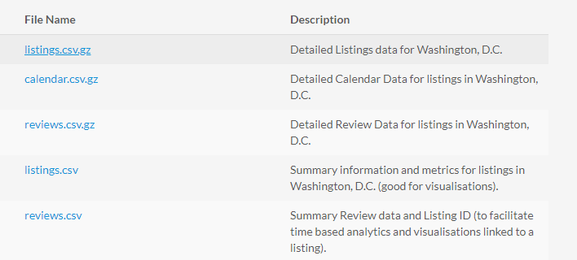
Datasets
http://insideairbnb.com/get-the-data.html

Slide 5
Features
accommodates: the number of guests the rental can accommodate
bedrooms: number of bedrooms included in the rental
bathrooms: number of bathrooms included in the rental
beds: number of beds included in the rental
price: nightly price for the rental
minimum_nights: minimum number of nights a guest can stay for the rental
maximum_nights: maximum number of nights a guest can stay for the rental
number_of_reviews: number of reviews that previous guests have left

Slide 6
Machine Learning
Build the Models (OLS Regression and Gradient Boosting).
Extract features and determine the most important ones.

Slide 7
Questions?
danielp2@umbc.edu

